Slide 1
Introduction
SOUL
Date 3 Month 10 Year 2025
Order: | Full name | Roll No.
1. | Tran Phuc Khang | Student1614879
2. | Mai Thanh Dat | Student1614903
3. | Nguyen Kim Minh | Student1614880

Slide 2
Content
Introduction
Aims and Objectives
Function/Non-function of the project
Test result
Conclusion and development
Task list

Slide 3
Introduction - Aims and Objectives
What is SOUL stands for?
This project, named “SOUL”, is designed as a sample application that demonstrates how technology can bring together a wide range of knowledge and information. “SOUL” aims to provide access to content such as historic monuments, general knowledge, and even modern technology skills.
It acts as a simple yet powerful tool to show how information from different domains can be gathered and presented in a structured way. Working on “SOUL” will also allow us to understand how small projects can eventually scale into larger, more robust applications

Slide 4
Introduction - Aims and Objectives
Technology
Backend (Laravel API)
Laravel (laravel/framework trong composer.lock)
Frontend (Next.js app)
Next.js
TailwindCSS

Slide 5
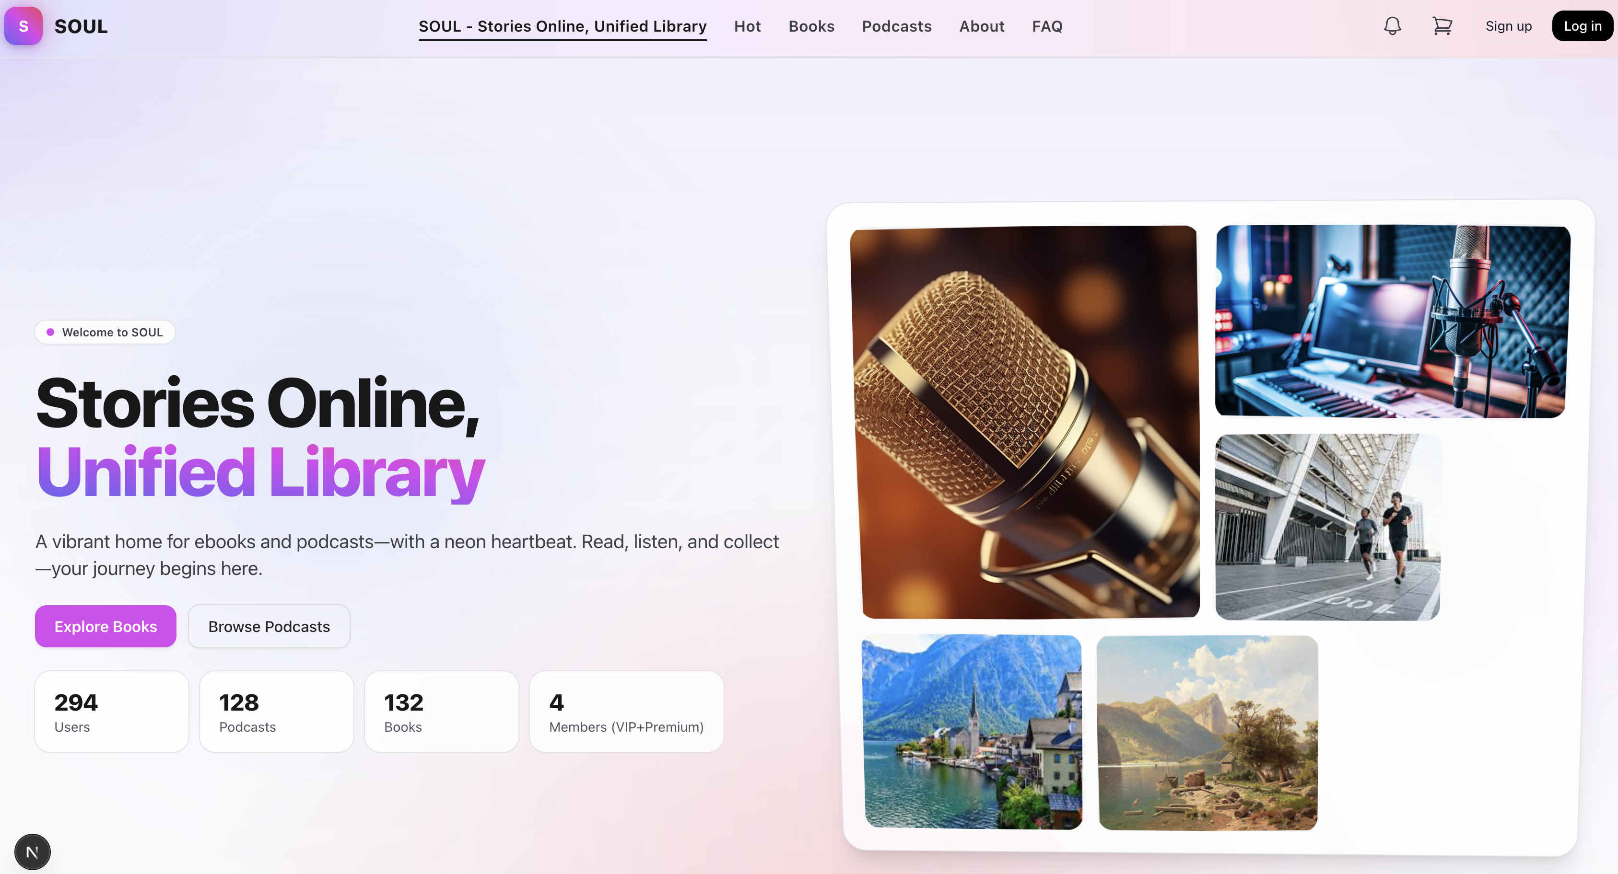
Introduction -Actual requirements
See trending or popular content.
Functions:
Direct access to the ebooks section.
Direct access to the podcasts section.
Learn more about SOUL.
Find answers to common questions.
Login or Create new account

Slide 6
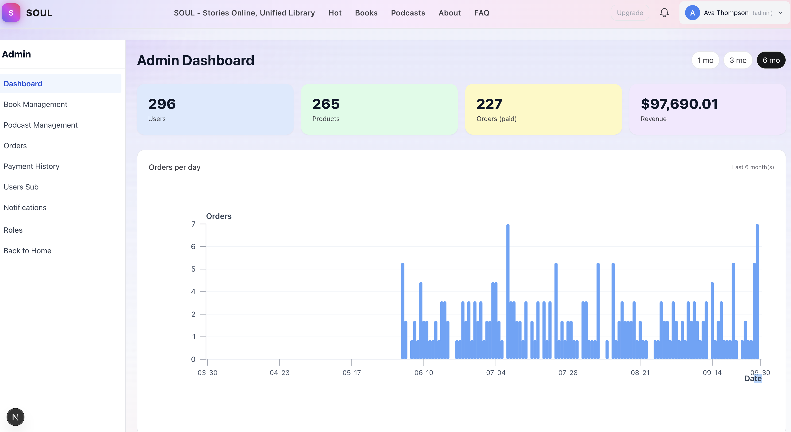
Introduction - Requirements of the project
Functional
SOUL Admin Dashboard – Sidebar Guide
1. Dashboard
Opens the main overview page.
Shows key metrics: total users, products (books + podcasts), orders, and revenue.
Includes a graph of orders per day over a selected time range (1 month, 3 months, 6 months).
2. Book Management
Manage the ebooks in the system.
Functions typically include:
Add new books (title, author, description, file upload).
Edit existing books (update info, replace files).
Delete books.
View book statistics (downloads, reads).
3. Podcast Management
Manage the podcasts in the system.
Functions:
Upload new podcast episodes (audio file + details).
Edit podcast information (title, description, host).
Delete podcasts.
Track listens/streams.
Notes:
Non-functional (how the system works)
Functional (what the system should do)

Slide 7
Introduction - Requirements of the project
4. Orders
Manage all customer purchases (books, podcasts, subscriptions).
View details:
Order ID
User info
Payment status (paid/pending)
Date & revenue amount
5. Payment History
Detailed list of all transactions.
Useful for accounting & financial tracking.
Likely includes filters: by date, amount, user, or method (credit card, PayPal, etc.).
6. Users Sub (User Subscriptions)
Manage subscription plans (Free, VIP, Premium).
Functions:
See who is subscribed to what plan.
Upgrade/downgrade users.
Track subscription start & renewal dates.
7. Notifications
Manage system notifications.
Functions:
Send announcements to users.
View system alerts (failed payments, errors, etc.).
Track which notifications have been read.
8. Roles
Manage user roles and permissions.
Functions:
Define admin, editor, moderator, or standard user roles.
Control who can access which features (example: only admins can manage payments).
9. Back to Home
Exit the admin panel.
Redirects back to the main SOUL homepage (the customer-facing website).
Notes:
Non-functional (how the system works)
Functional (what the system should do)

Slide 8
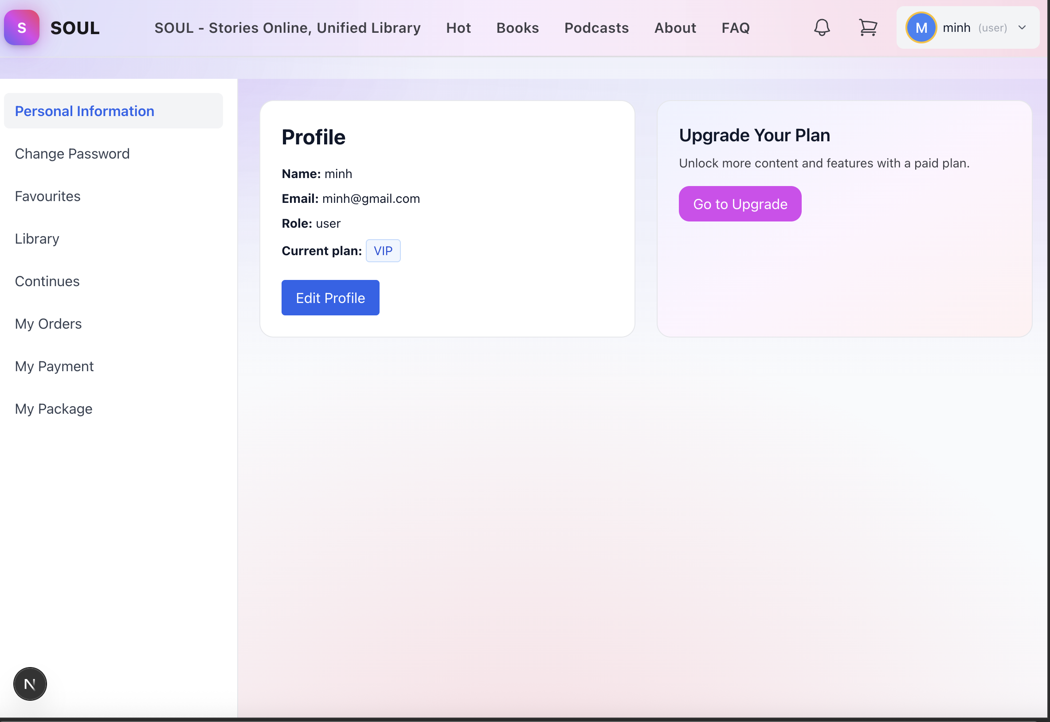
Introduction - Deployment diagram
SOUL User Dashboard – Sidebar Guide
1. Personal Information
View and edit your profile details (name, email, role, and current subscription plan).
Button: Edit Profile → allows you to update your information.
2. Change Password
Update your account’s password for security.
Usually requires entering old password → new password → confirm new password.
3. Favourites
Shows the list of ebooks and podcasts you’ve saved as favourites.
Quick access to your preferred content without searching again.
4. Library
Your personal library of books and podcasts.
Displays all the content you’ve purchased, borrowed, or unlocked.
5. Continues
“Continue Watching/Reading/Listening” section.
Lets you pick up where you left off in books or podcasts.

Slide 9
Introduction - Deployment diagram
6. My Orders
Shows your purchase history (books, podcasts, or bundles).
Includes order ID, payment status, and date.
7. My Payment
Manage your payment methods (credit card, PayPal, etc.).
View payment history and billing details.
8. My Package
View and manage your subscription plan (Free, VIP, Premium).
Options to:
See current plan status.
Upgrade or renew subscription.
Check expiry/renewal dates.

Slide 10
Non-Functional
1. Security
All data in transit must use HTTPS (TLS 1.2 or higher).
Users must log in with multi-factor authentication (MFA).
Passwords stored using bcrypt or Argon2 hashing.
2. Usability
The UI must not be used mobile responsive.
90% of new users should be able to complete onboarding within 5 minutes.
Follow WCAG accessibility guidelines (e.g., color contrast, alt text).
3. Maintainability
The codebase must follow PSR-12 coding standards (PHP example).
All modules should include unit tests with at least 80% coverage.

Slide 11
Test Result [1-n]
Sr.No | Aspected Tested | Suggestion/ Remarks
1 | Are all the users able to view the images and links? | PASS
2 | Have all the views, modules and controllers been properly integrated and is the site function as a single page application? | PASS
3 | Are the GUI content devoid of spelling mistakes? | PASS
4 | Is the application user-friendly? | PASS
5 | Is the Website launching correctly in all popular browsers? | PASS
6 | Are all the forms validated with proper criteria? | PASS
7 | Do all text links lead to the appropriate website? | PASS
8 | Do all image links lead to the appropriate website? | PASS
9 | Are all the images and links clearly visible on the page? | PASS
10 | Does the Web page work properly in all the tested browsers? | PASS
11 | Does the Web page take too long to be loaded fully? | PASS
12 | Is the navigation sequences correct through all the Web pages on the site? | PASS
13 | Is the JavaScript code working as expected in all click events? | PASS

Slide 12
Conclusion
Application will help user automate everything, making their work easier for users.

Slide 13
Development
Building applications using PHP/Laravel and MySQL database.

Slide 14
Task List
No | Member | Contents |  | Table Name
1 | Trần Phúc Khang | Admin | User Managemet | Users, user_subscriptions favourites
2
3 |  | User | Subscription Management, Favorites Management
4
1 | Mai Thanh Đạt | Admin | Order Management | orders, order_items, payments
2
3
4 |  | User | Order Management
5 |  | Payment getway | Payment Processing
1 | Nguyễn Kim Minh | Admin | Product Management | products, Product_files, continues
2
3 |  | User | Progress Tracking
4

Slide 15

Thank You

Slide 16
Reference

